Slide 1
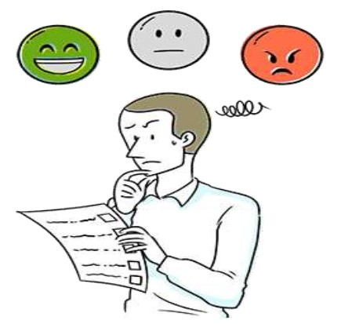

Online Real Time Twitter Sentimental Analysis
EXCITING INNOVATIONS THAT CAN CHANGE THE WORLD

Slide 2


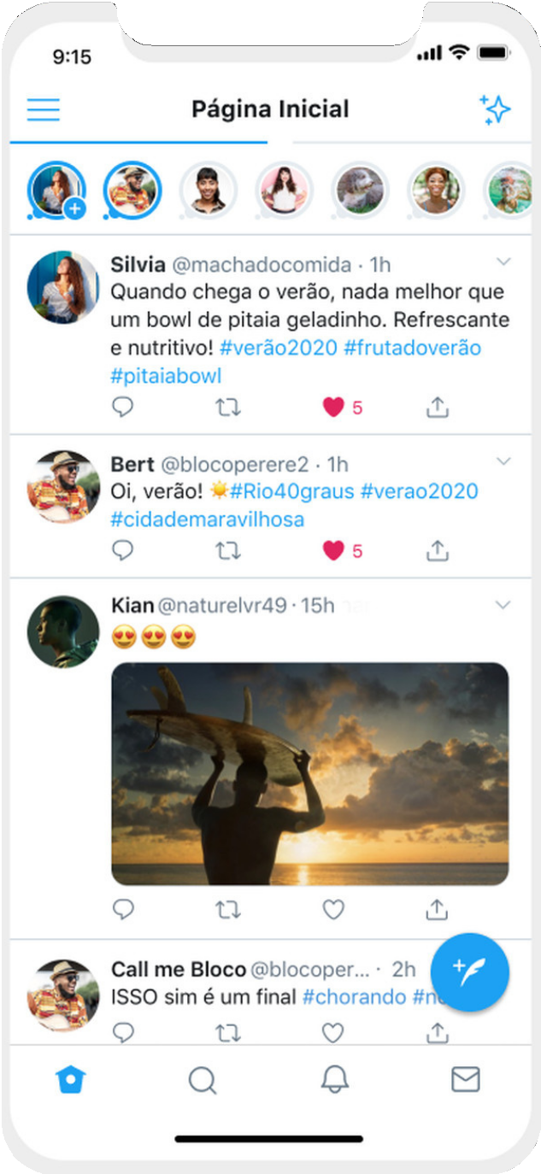
MINOR PROJECT-2
GUIDE’S NAME- DR. RAVINDRA KUMAR SINGH MITESH KUMAR(181B125)
ASHISH KUMAR SINGH(181B55)
ANJALI DUBEY(181B037)

Slide 3
01
We want to create a platform where anyone can search about postive,negative and neutral viwes/sentiments about any person,product,sitution of surrounding in real time.
HOW THE IDEA TRIGGER??
Using the analysis, person, company,political parties etc can analyze themselves and their product and can make it more better in future.
02

Slide 4

SENTIMENT ANALYSIS ?
Sentiment Analysis is the process of determining whether a piece of writing is positive, negative or neutral.
Also referred to as opinion mining, it makes our goal to determine whether the data(tweet) is positive, negative or neutral.
neutral.

Slide 5
01
Business: In marketing field companies use it to develop their strategies, to understand customers’ feelings towards products or brand, how people respond to their campaigns or product launches and why consumers don’t buy someproducts.
Politics: In political field, it is used to keep track of political view, to detect consistency and inconsistency between statements and actions at the government level. It can be used to predict election results as well.
WHY
IS SENTIMENT ANALYSIS IMPORTANT?
02
Public Actions: Sentiment analysis also is used to monitor and analyse social phenomena, for the spotting of potentially dangerous situations and determining the general mood of the blogosphere.
03

Slide 6
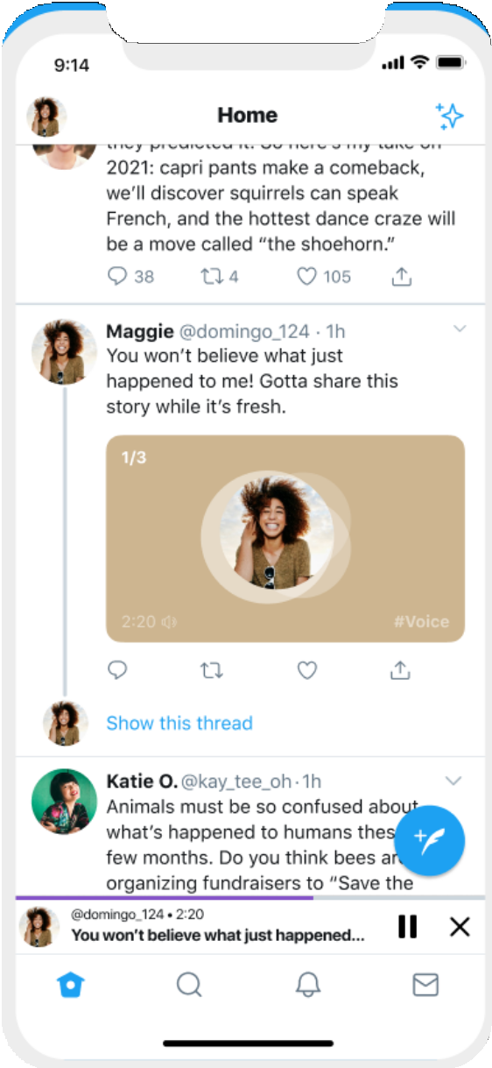
WHY TWITTER DATA FOR SENTIMENT ANALYSIS?
Popular microblogging site.
Short Text Messages of 140 characters.
3. 240+ million active users.
4. 500 million tweets are generated everyday.
Twitter audience varies from common man to celebrities.
Users often discuss current affairs and share personal views on various subjects.
Tweets are small in length and hence unambiguous.

Slide 7
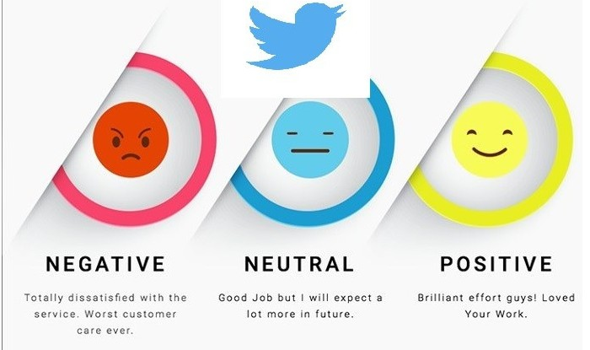
TALK ABOUT STATISTICS
Brandwatch reports that there are 500 million tweets daily which means around 6k tweets per second! With 24.3% of verified users being journalists, it will be true that you should be able to easily get credible news and information here.

Slide 8




Approximately 6 of every 10 (63 percent) Twitter users worldwide are between 35 and 65 years old (theVAB, 2018).
67 percent of all B2B businesses are using Twitter as a digital marketing tool (Statista, 2018).
4 out of 10 Twitter users carried out a purchase after having come across it on the social media platform (Digital Marketing Institute, 2019).

Slide 9

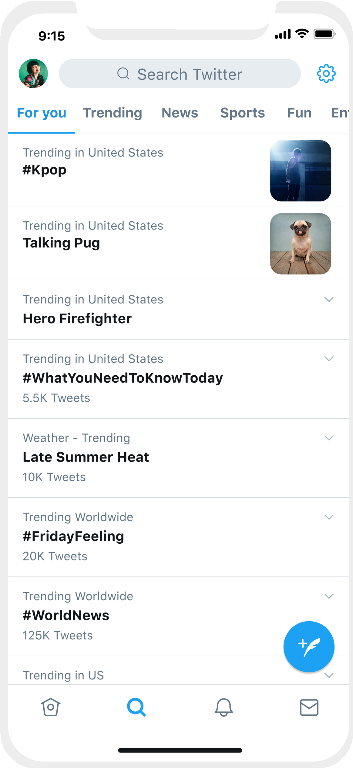


RAW IDEA ABOUT THE PROJECT HOW IT WILL BE DEVELOPED
4 main function the project:-
1.Show Recent Tweets 2.Generate WordCloud
3.Visualisation for Sentiment Analysis 4.Last 100 Tweets Subjectivity and Polarity
Using Streamlit we will make this project as web based application.
we have the twitter developer account for the API.

Slide 10
FEASIBILITY STUDY:
A FEASIBILITY STUDY IS A PRELIMINARY STUDY WHICH INVESTIGATES THE INFORMATION OF PROSPECTIVE USERS AND DETERMINES THE RESOURCES REQUIREMENTS, COSTS, BENEFITS AND FEASIBILITY OF PROPOSED
SYSTEM.
TECHNICAL FEASIBILITY
OPERATIONAL FEASIBILITY
ECONOMIC FEASIBILITY
This is a web based application. Creation of application is not costly. This could increase improvement in productquality, better decision making, and timeliness of information, expediting activities,improved accuracy of operations, better documentation and record keeping, faster retrieval of information.
Is the required technology available? Our system is technically feasible since all the required tools are easily available.
effective controls to protect against fraud and to guarantee accuracy and security of data and information.
Proposed project is beneficial only if it can be turned into information systems that will meet the operating requirements. The proposed was to make a simplified web application. It is simpler to
operate and can be used
in any webpages. It is free and not costly to operate.

Slide 11

SOFTWARE AND HARDWARE REQUIREMENTS:
SOFTWARE REQUIREMENTS:-
Operating System: Windows 7/8/8.1/10 Anaconda
Language used-python
HARDWARE SPECIFICATIONS:-
: Intel i5 or more
: Intel® Chipset Motherboard.
: 8GB or more
: 512 KB
: 16 GB hard disk recommended
: 1.44MB Floppy Disk Drive
: 1024 x 720 Display
: 2.7GHZ and more
Processor Motherboard Ram
Cache Hard disk Disk Drive Monitor Speed

Slide 12
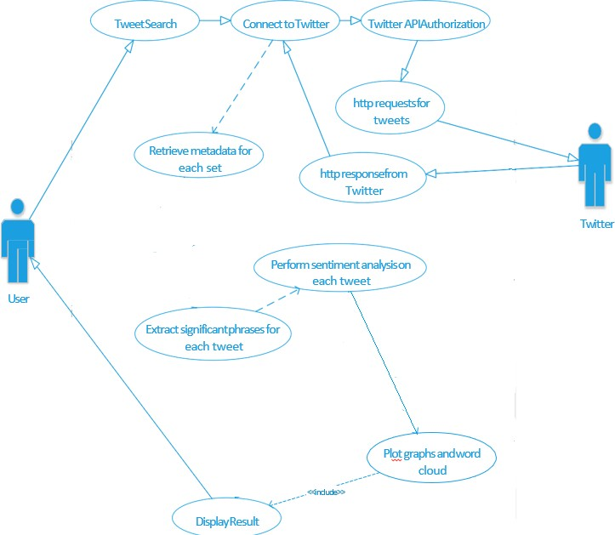
USE CASE DIAGRAM
It is an effective technique for communicating system behavior in the user's terms by specifying all externally visible system behavior.

Slide 13
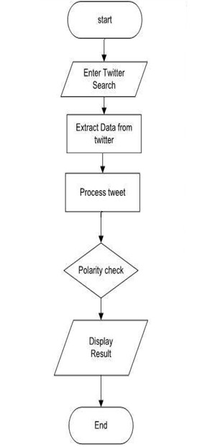
ACTIVITY DIAGRAM
Activity diagram is basically a flowchart to represent the flow from one activity to another activity. The activity can be described as an operation of the system.

Slide 14
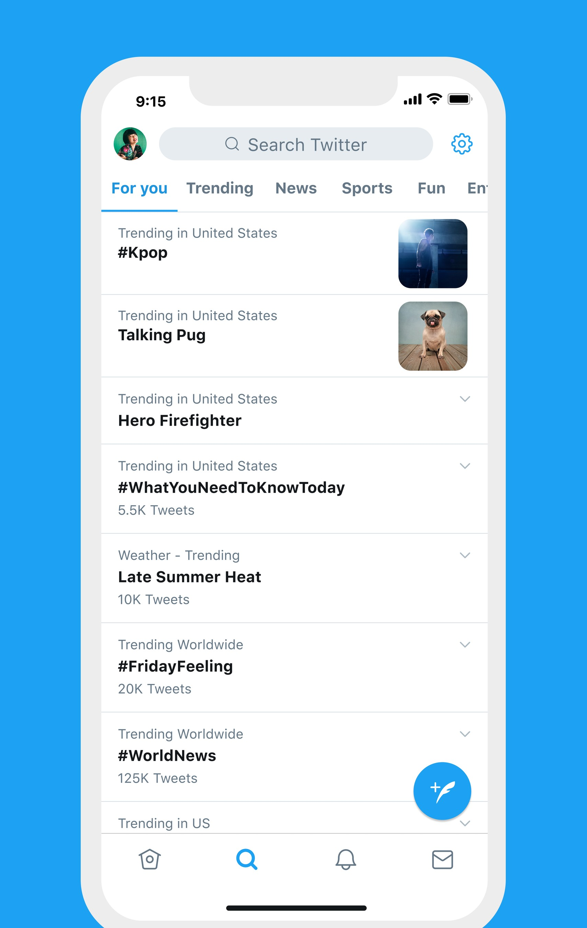
CHALLENGES
People express opinions in complex ways.
In opinion texts, lexical content alone can be misleading.
Intra-textual and sub-sentential reversals,negation,topic change common. 4.Rhetorical devices/modes such as sarcasm, irony,implication, etc.
5.Unstructured and also non-grammatical. 6.Extensive usage of acronyms like asap, lol,afaik.

Slide 15
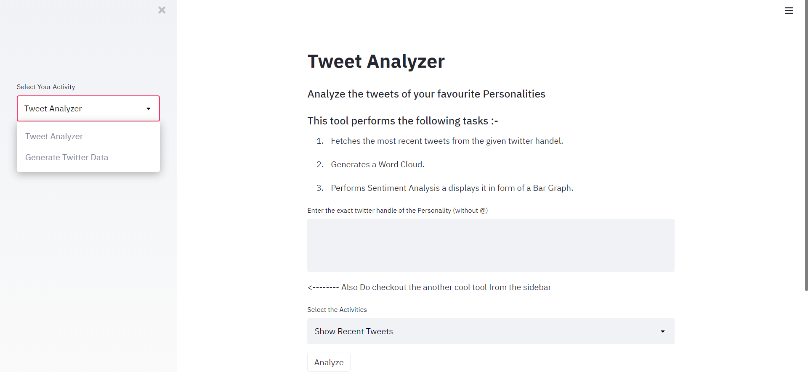

Slide 16
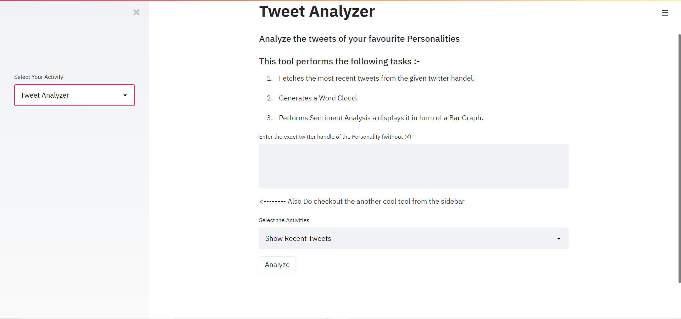

Slide 17
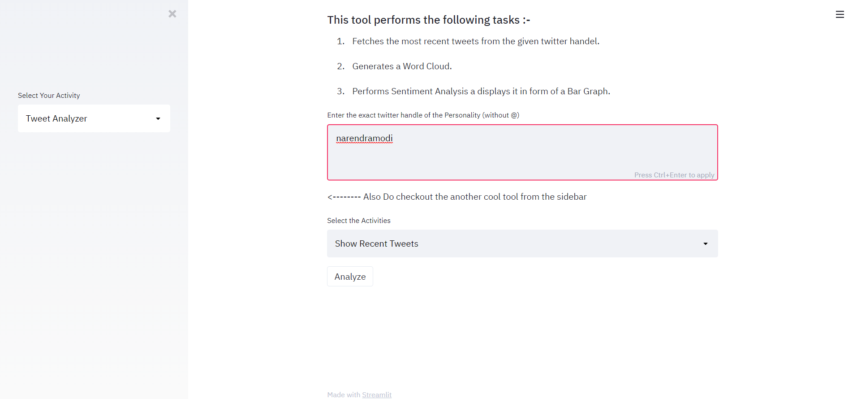

Slide 18
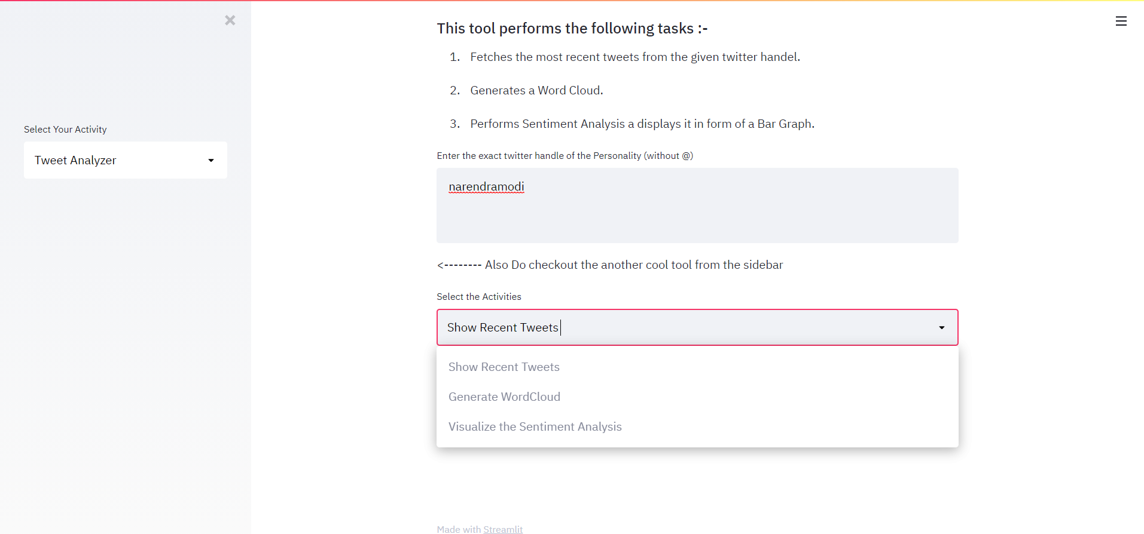

Slide 19
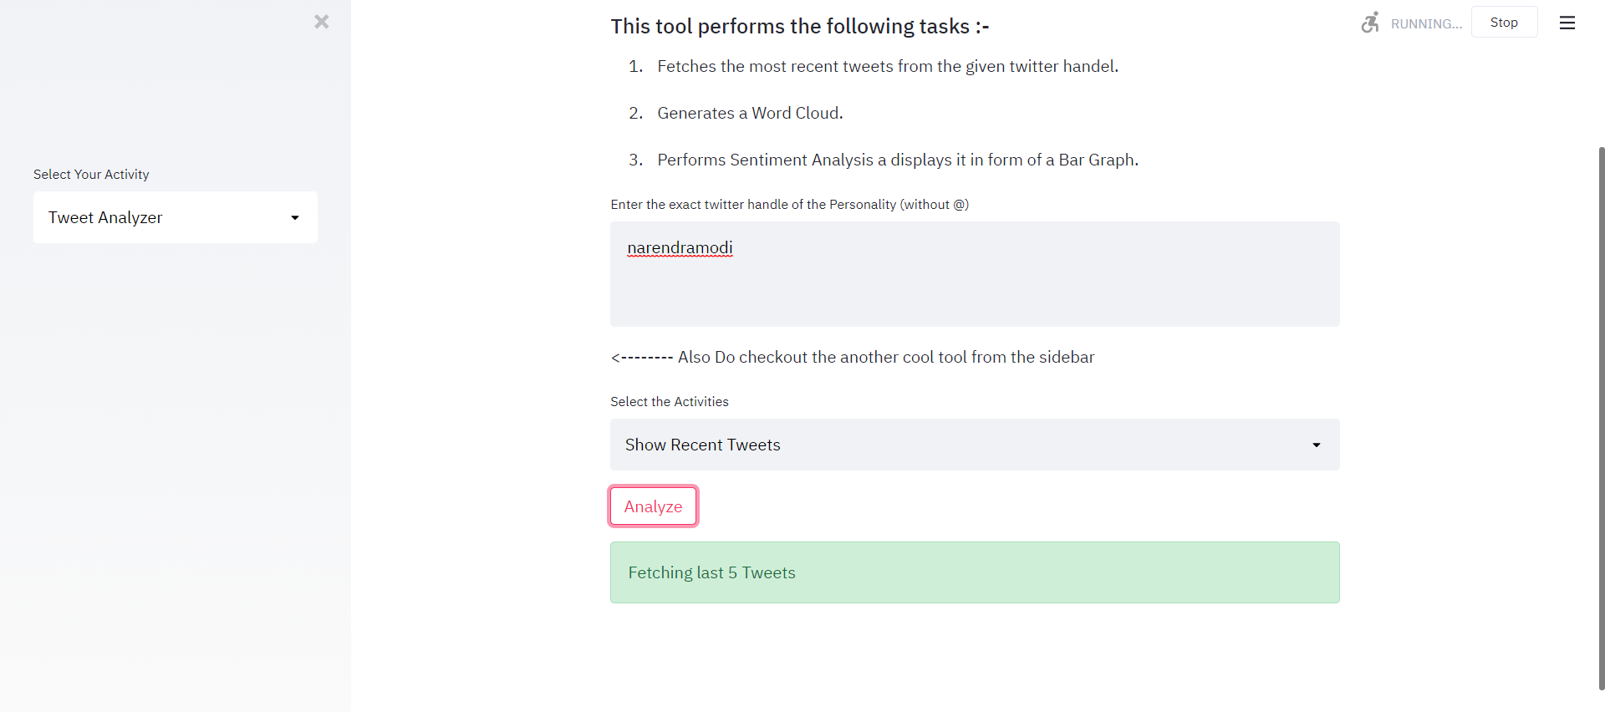

Slide 20
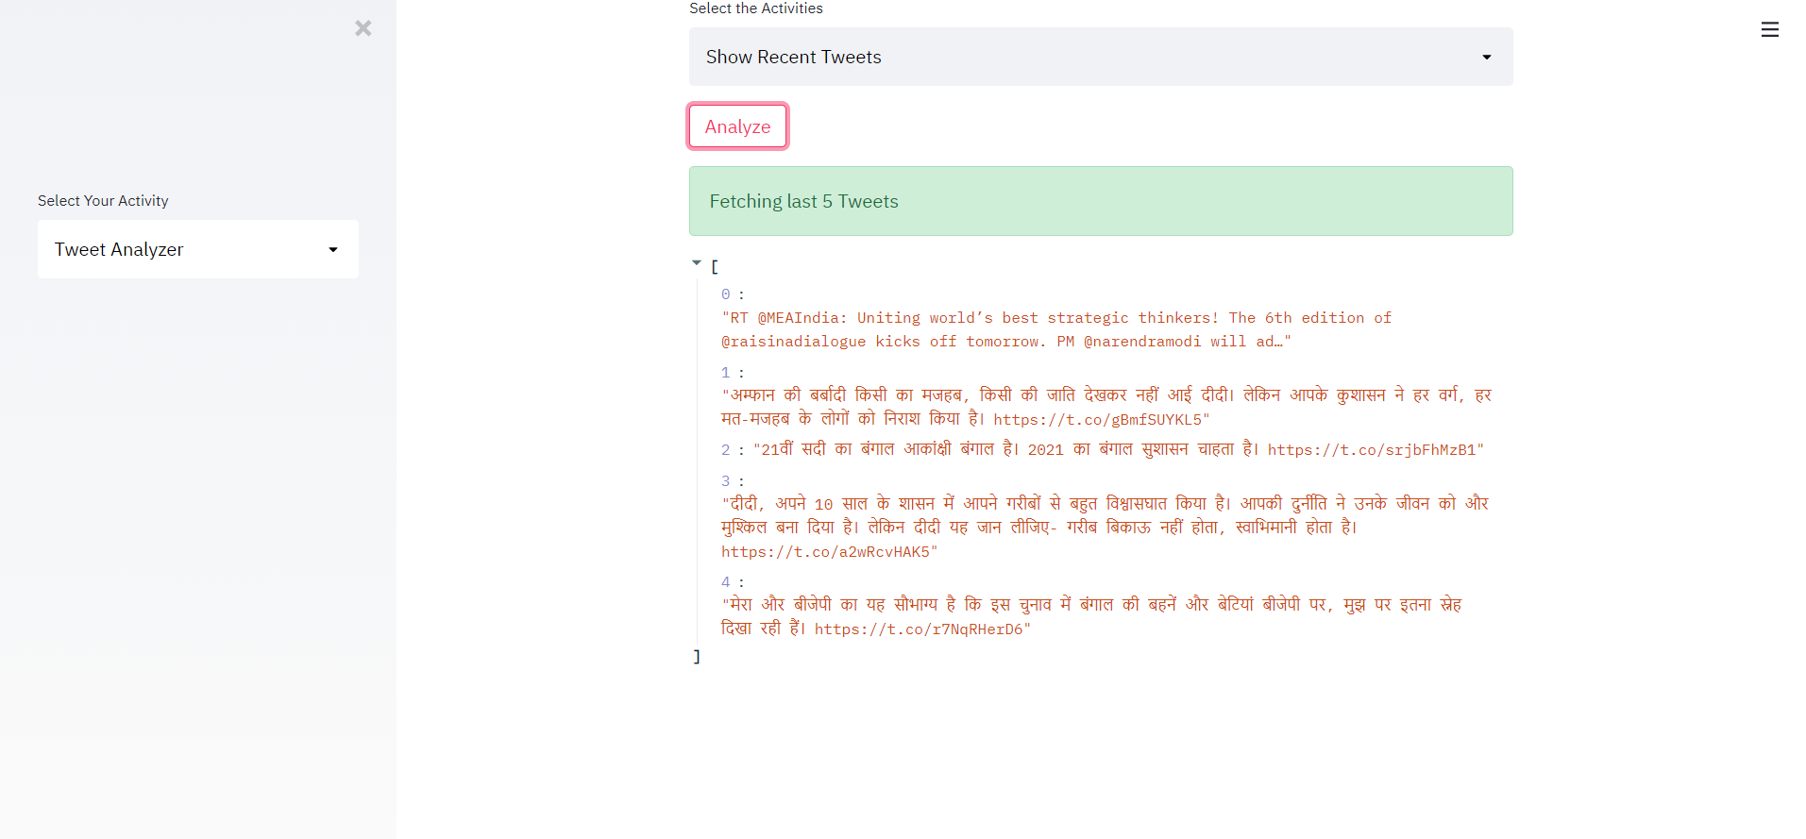

Slide 21
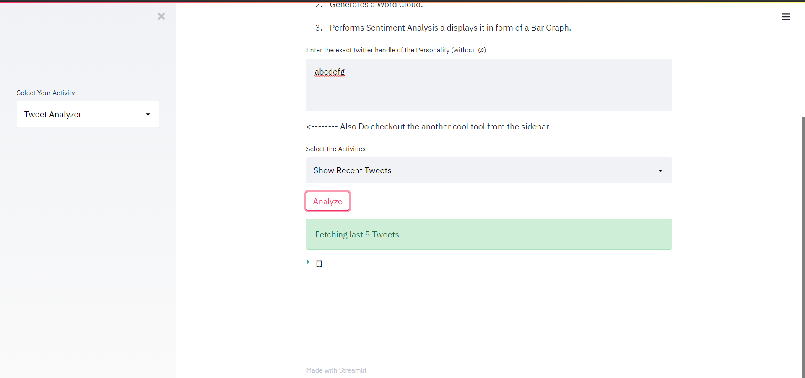

Slide 22
Term Paper
Title: Online Real Time Twitter Sentimental Analysis
Concepts: ML,NLP, Data Science
Tools: Python, Jupyter Notebook, Streamlit, NLTK

Slide 23
Term Paper
Description: Twitter Sentiment Analysis Platform and Technologies
Case Study
Project Limitation & challenges
Goal: to prepare a definition research paper on Real Time Twitter Sentimental Analysis

Slide 24
References
https://en.wikipedia.org/
https://www.w3schools.com/
https://www.youtube.com/
Dr. Khalid N. Alhayyan & Dr. Imran Ahmad “Discovering and Analyzing Important RealTime Trends in Noisy Twitter Stream” n.p
R. Sharma, S. Nigam, and R. Jain, "Opinion mining of movie reviews at document level," arXiv preprint arXiv:1408.3829, 2014.
R. Sharma, S. Nigam, and R. Jain, "Polarity detection at sentence level," International Journal of Computer Applications, vol. 86, no. 11, 2014.

Slide 25


Slide 26


